Slide 1
P56: Benchmark Commercial AI product for Medical Imaging Services Provider
Kiran Papalkar 490411205 kpap8603 Bronte Lee 490420056 blee6992
Benjamin Men 500401903 jmen0495
Zheyuan Zhang 500023392 zzha3548 Cailin Feldman 480439062 cfel2589
Andersen Liu 480022439 bliu3122(Other group name: SOFT3888_TU12_01(RE), project name: P08 - WeBike)
Zichen Li 500174041 zili4471 (Other group name: SOFT3888_W16_02(REMOTE), project name: P25 - Travel plan and diary application)
Project Name: Benchmarking Commercial AI-ISYS3888
Project Period: 2022/8 - 2022/12
Sponsor(s) Client: Professor Simon Poon
Organisation: USYD
Project Supervisor: Yaoqi Huang
Class Time: Tuesdays 3:00pm-5:00pm

Slide 2
01
Introduction

Slide 3
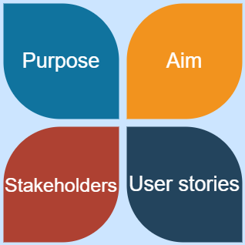
Introduction
Purpose:
Compare qXR and other medical imaging AI products.
qXR, to buy or not to buy?
Aim:
qXR VS other products
Performance + UX
Systematic Review
Meta-analysis
Stakeholders:
Client
ABC Company
Radiologists
Hospital managers
...
User stories:
Radiologists:
Find the best product.
The decision on using qXR.
The impact on current workflow.
Developers:
How to improve?

Slide 4
02
Feedback Changes

Slide 5
Feedback
With the feedback received we have:
Made an outline and followed systematic review protocols
Rewritten answers that now
include our own analysis
have supporting evidence for every decision we have made
Notes:
“Before we continue with our presentation, we would like to reassure you that we have taken the feedback given to us from you from the first deployment to improve our report.
how we have made an outline and followed systematic review protocols,
rewritten answers making sure we include analysis, and have supporting evidence for every decision we have made

Slide 6
03
Testing

Slide 7
Testing Plan
Quality Assurance Testing
Article Quality
Systematic Review Quality
Meta-analysis Quality
Thematic Analysis Quality
Evaluation Quality
Report Quality
Presentation Quality

Slide 8

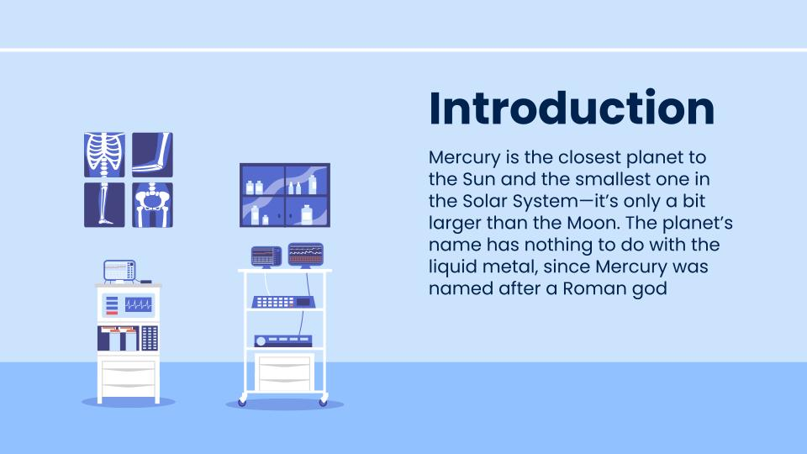
04
Report

Slide 9
Relevance
01

Slide 10
1.1 What is the Problem and Who is it for?
Bridge gap between incidence of TB and reported cases
Diagnoses at a much faster rate than human readers
Patients needs addressed more efficiently
Locates 30 different CXR abnormalities and forms a report
End users are radiologists and medical imaging facilities
Patients are also heavily impacted

Slide 11
1.2 Benefits
Time-efficient
Automate interpretation
Reduce misdiagnosis
Accurately positioning patients
Identify abnormalities
Enhance workflow
qTrack

Slide 12
1.3 Risks
Ethical issues and legal liability problems
Cybersecurity and data protection
Data been compromised

Slide 13
Performance and Validation
02

Slide 14
2.1 Algorithm’s Design Specifications
Step one:
Decomposes the task into different subtasks by Deep neural network (DNN)
Step two:
Output them and learn the underlying features
0.77 Dice score
Notes:
The algorithm can be divided into two parts. Step 1: The development team uses an automatic segmentation model consisting of a deep neural network (DNN) to decomposes the task into different subtasks
Step 2 is data output and learning the underlying features
finally, qxr algorithm's dice score is 0.77, which is very acceptable

Slide 15
2.2 Algorithm Training
60% training set
Sample size: 24,384 CXRs
Trained an 18-layer deep residual convolutional neural network (just for health or not)
Also conducted a test for different symptoms ("cardiomegaly", "opacity", and "pleural effusion")
Find the feature has the most influence on CXR —> the prediction difference analysis
20% validation set
20% test set
Notes:
The qXR team collected 24,384 CXRs for testing. Sixty percent of them are training sets, 20% are validation sets, and 20% are test sets. Project team Trained an 18-layer deep residual convolutional neural network (just for testing the CXR is health or not) Also conducted a test for different symptoms ("cardiomegaly", "opacity", and "pleural effusion")
And the project team also Uses the prediction difference analysis to find the feature has the most influence on CXR

Slide 16
2.3 Performance Evaluation

Slide 17
2.3.1 Method
Systematic review
PRISMA-P
Search queries
Inclusion/exclusion criteria
Find articles
Extract data
Meta-analysis
Forest plot
SROC plot

Slide 18
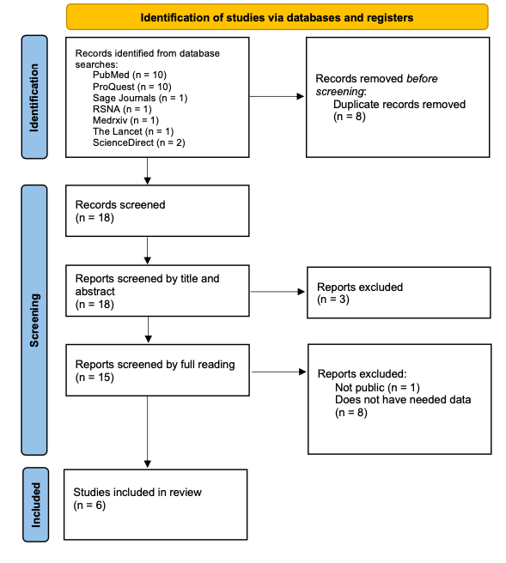
2.3.2 Systematic Review

Slide 19
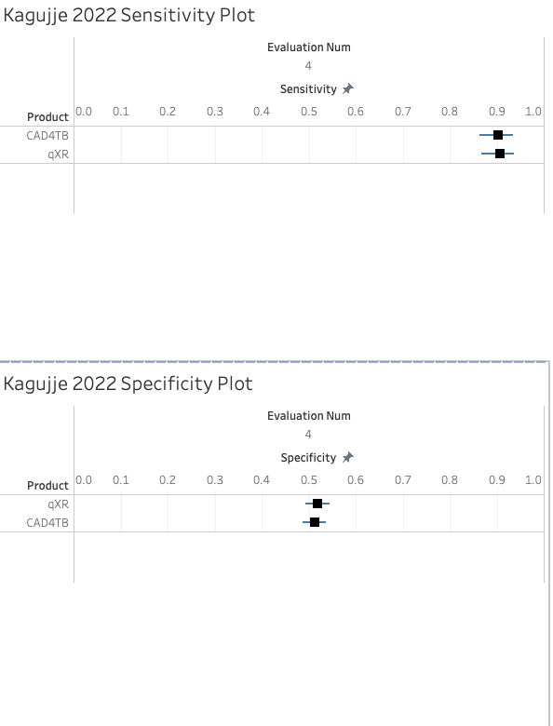
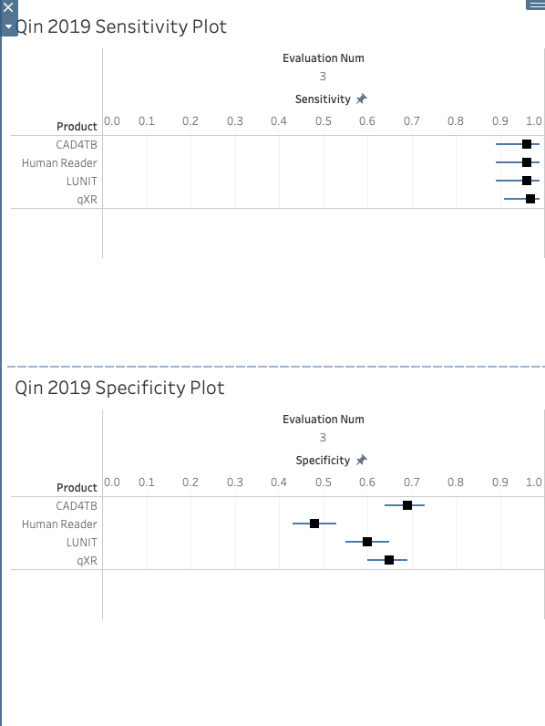
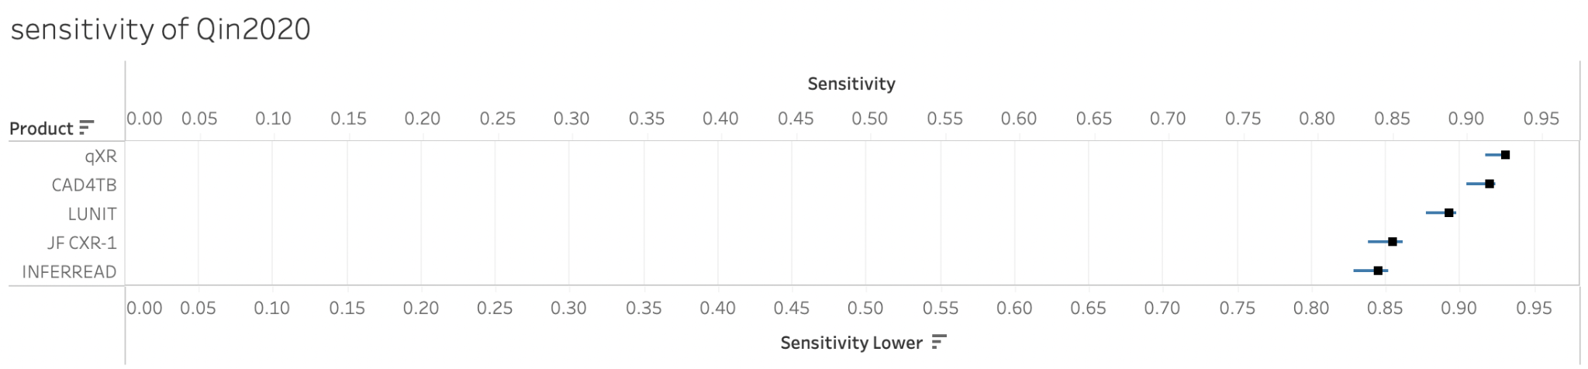
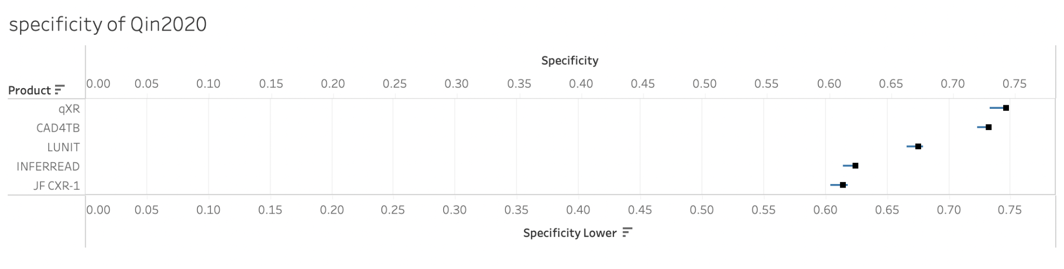
2.3.3 Heterogeneity

Slide 20
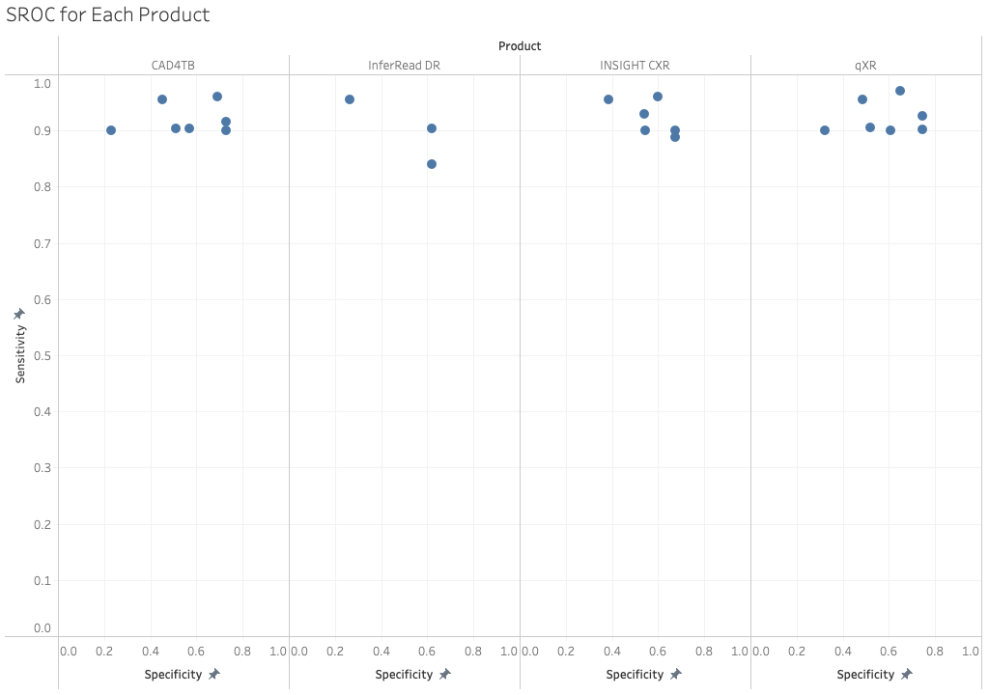
2.3.4 Results and Discussion
As each identified study used a sensitivity threshold the main analysis is of the product’s specificity at each threshold.
CAD4TB ≈ qXR > others
Different articles have different opinions
Time limitation
Finally -> qXR
Notes:
This sroc diagram illustrates the variability of sensitivity and specificity for each product across different studies. As each identified study used a sensitivity threshold, the main analysis is of the product’s specificity at each threshold. Due to this, clear standout performances by qXR and CAD4TB can be observed
In all articles, there are some authors who think LUNIT is the best, but in others it is opposite. Another limitation is the time dimension, and the versions of ai products evaluated by articles in different periods are also different. Recent articles from this year also showed lower specificity scores for CAD4TB, which was interpreted as the algorithm being less effective at diagnosing patients with a history of TB.
So our final choice is qxr

Slide 21

2.4 Bias
Selection Bias
Combination of CT scans and algorithmically selected dataset
Underdiagnosis Bias
Underserved populations can have different diagnoses

Slide 22
2.5 Is the algorithm fixed or adapting as new data comes in?
qXR was repurposed to Covid-19 diagnosis
qXR took additional one million CXRs for training for training between 2020 and 2022

Slide 23
Usability and Integration
03

Slide 24
3.1 Integrating qXR into the Workflow
Integration Options
API based
PACS Based
AI Marketplace (our teams choice)
Parkh (2019) states that the AI marketplace integration requires ‘little or no support’ and ‘offering end-to-end solutions’ that solve the engineering issues (deployment, workflow integration, etc.) and commercial issues (contracting, billing, etc.) that arise when implementing AI
Notes:
As qXR is a medical tool is used for patient diagnosis and treatment, ensuring that the radiology practice is compliant with clinical guidelines and standards. This includes making sure that their software is always up to date.
qXR can be integrated into the clinical workflow of a radiology practice in the following ways:
API based -> simple and intuitive method of accessing qXR
PACS Based: -> more complex method but allows for finer-grained control
A simple alternative is provided by Integration via AI marketplace or distribution platform. Parkh (2019) states that the AI marketplace integration requires ‘little or no support’ and ‘offering end-to-end solutions’ that solve the engineering issues (deployment, workflow integration, etc.) and commercial issues (contracting, billing, etc.) that arise when implementing AI
Once implemented and decisions on managing the technology are completed, training the radiological practices' staff is the final step.and should be noted that qXRs implementation and training is available from qure.
A large amount of time should be dedicated to improving the user’s knowledge as this improves the user’s attitudes towards qXR (this finding is further expanded on in section 3.2.7) .

Slide 25
3.2 Impacts When Integrating qXR
How exactly does the product impact the workflow?
Focus Question
Answered by the User Experience Team
Systematic review and thematic analysis

Slide 26
3.2.1 Introduction
Impact on the workflow from a radiologist’s perspective
Limitation: no studies specific to qXR
Solution: examine AI in radiology and apply these results to qXR

Slide 27
3.2.2 Methods
Data Synthesis
Thematic Analysis
Codebook
Conceptual framework: UTAUT
Deductive, inductive where needed
Coding
Individual initial coding
Team discussion to finalise coding
Results and discussion
Themes and conclusion
Systematic Review Protocol
Eligibility criteria
Information sources
Database queries

Slide 28
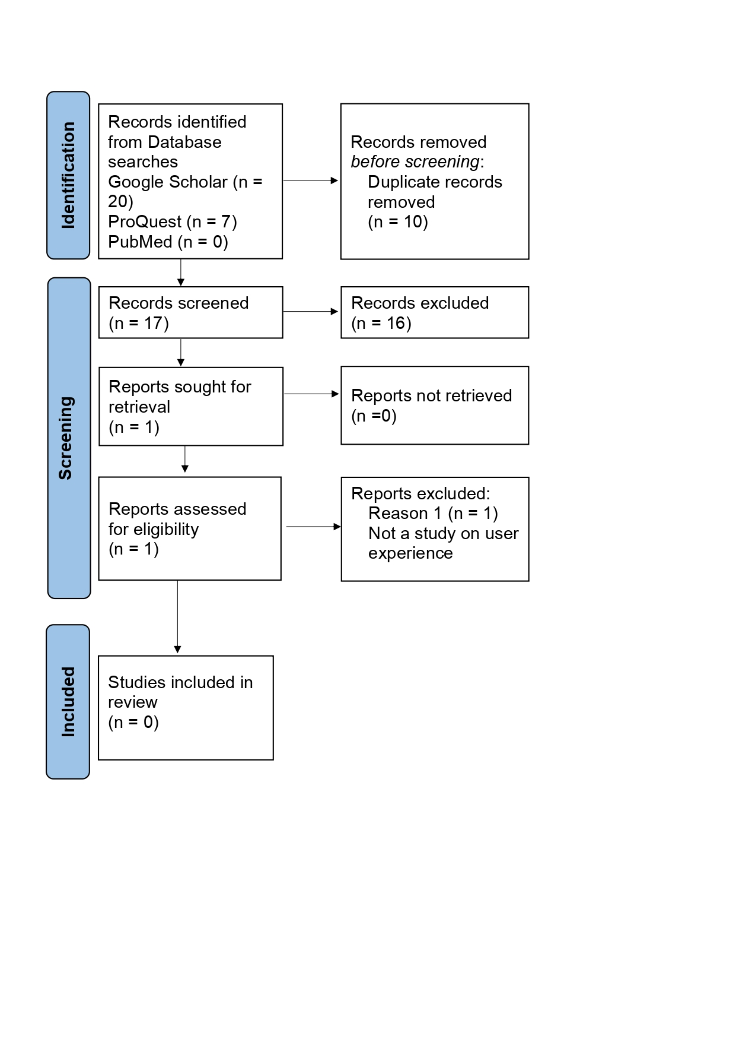
3.2.3 Systematic Review of qXR
Execute search queries in all information sources
Collect all results
Exclude based on title and abstract
Exclude based on full-text

Slide 29
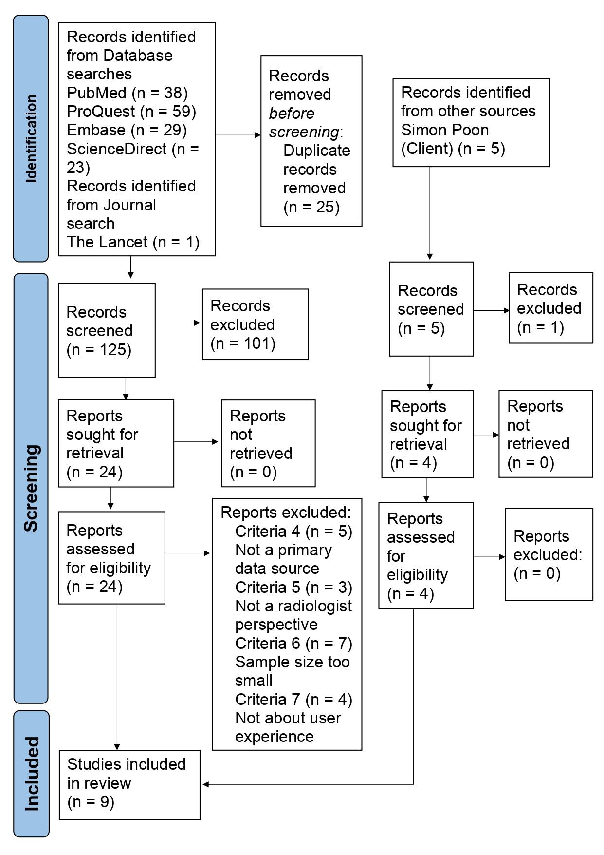
3.2.4 Systematic Review of AI in Radiology
Steps:
Protocol writing
Study collection (PRISMA)
Characteristics analysis
Data extraction
Thematic review

Slide 30
3.2.5 Results - Theme 1: Performance Expectancy
PE1: Efficiency
Explanations “save time for a clinician”
PE2: Effectiveness
82.8% agreed that AI can help reduce radiation dose levels while maintaining optimal image quality.
42% of respondents was that technical performance was inconsistent
PE3: Extrinsic Motivation
61.3% concerned that AI would replace most jobs and negatively affect the profession rather than just being an assistive tool
62% disagreed that radiologists’ jobs were in danger due to AI

Slide 31
3.2.5 Discussion - Theme 1: Performance Expectancy
PE1: Efficiency
77% of respondents agreed that AI can be used to help diagnostic radiology by workflow optimisation
PE2: Effectiveness
Expected benefit, however, a current concern
PE3: Extrinsic Motivation
Level of AI knowledge determined how radiologists felt about their job security

Slide 32
3.2.6 Results - Theme 2: Effort Expectancy
Effort Expectancy is degree of ease associated with the use of the system
Ann Oper Res (2020) and A.V. Prakash and S. Das 2021 studies found effort expectancy has an insignificant score of when measuring its influence on behaviour intention with respective scores of (β = 0.078, p > 0.05) and (β = 0.004 , p > 0.05).
Notes:
Effort expectancy is defined as the degree of ease associated with the use of the system (Venkatesh et al., 2003)
It is interesting to note that in several studies, it reveals that effort expectancy has no significance in influencing behavioural intention This phenomenon is demonstrated Ann Oper Res (2020) study where they found effort expectancy has an insignificant score of (β = 0.078, p > 0.05 when measuring its influence on behaviour intention. This idea's conclusion is further illustrated from the A.V. Prakash and S. Das 2021 study where they had a (β = 0.004 , p > 0.05). where they also measured the impact effort expectancy has on behavioural intention.

Slide 33
3.2.6 Discussion - Theme 2: Effort Expectancy
Radiologists are used to highly complex machines (A.V. Prakash and S. Das 2021) therefore E.O.U. is no longer an influential criterion
However to help Qure.AI stay competitively advantaged, a client collaboration with Qure.AI can be beneficial
So getting client’s users to complete an effort expectancy-focused survey with questions that include:
List all the reasons that made you believe the system seemed: easy to use/difficult to use
reasons why you felt using the system was easy to use/complex to use
Notes:
A.V. Prakash and S. Das explain the reason for the insignificance of the effort expectancy metric is that ‘radiologists are used to highly complex machines in their routine clinical practice, and the ease of use associated with the system may not factor in as an influential criterion in the adoption-related decision-making. Another reason may perhaps be that radiologists did not foresee any difficulty in using ICDDSS, and they perceived the use of ICDDSS to be as easy as using their current systems/machines.’
However, it would be beneficial for our clients to collaborate with Qure.Ai to help improve the qXR. Our team suggests our client to complete effort expectancy-focused surveys, with questions that include “list all the reasons that made you believe the system seemed: easy to use/difficult to use”, “reasons why you felt using the system was easy to use/complex to use” that can be shared with qure.Ai where they take effort expectancy findings into account when designing their technology to make sure they improve their customer’s user experience.

Slide 34
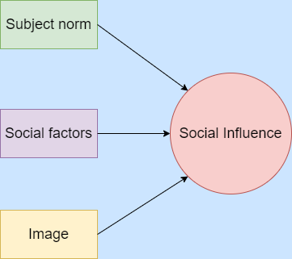
3.2.6 Results - Theme 3: Social Influence
Subject Norm:
Thinks of patients.
69% excited about AI.
26.5% neutral.
4.4% not excited.
Social factors:
78.2% Aware of the trend.
19.8% neutral.
1.9% Not aware.
Image:
No data.

Slide 35
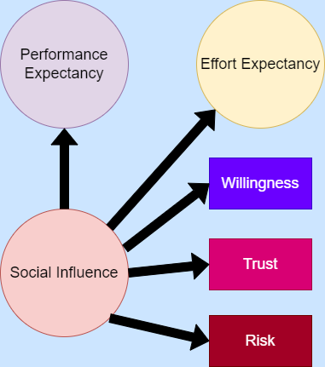
3.2.6 Discussion - Theme 3: Social Influence
The majority of the participants think patients are excited about AI.
The trend of using AI is being recognized internationally.
Less than half of the managers or hospitals hold an open attitude.
Less than half of the organization has a promoter of AI.
Important but often times underestimated.

Slide 36
3.2.6 Results - Theme 4: Facilitating Conditions
Notable results include:
52% of radiologists noted that no knowledge of informatics/statistics and 75% of radiologists had no previous experience in programming (Merel Huisman, 2021)
Radiologist’s greatest barrier with learning AI technology Lack of dedicated courses and learning materials: 219 (21.5%); Lack of mentorship, guidance and support from “experts" 136 (13.3%); Lack of evidence-based material and proof of improved clinical outcomes 117 (11.5%); Lack of time to learn new technologies 33 (3.2%); Lack of funding/investment for new technologies
42% of radiologists felt that their workplace had unstructured planning and monitoring
Notes:
537 (52%) had no knowledge of informatics/statistics and 75% had no previous experience in programming (Merel Huisman, 2021)
Therefore it should comes as no surprises that a majority of users believed they require further education and/or training to be able to embrace these emerging AI trends in medical imaging (B.O. Botwe et al, 2021. This finding was further illustrated when Botwe asked radiologists what the believed are the greatest barriers for users when using new technology in their work place which they responded with -Lack of dedicated courses and learning materials: 219 (21.5%); Lack of mentorship, guidance and support from “experts" 136 (13.3%); Lack of evidence-based material and proof of improved clinical outcomes
Additional data findings for Facilitating conditions that Lea found was that in close to half of respondents agreed that their workplace had unstructured planning and monitoring when implementing AI. Lea also noted 33.3% of users felt that there was an absence of guidelines/best practices. Lastly, lea saw that 33% of users mentioned that there was no empirical evidence.

Slide 37
3.2.6 Discussion - Theme 4: Facilitating Conditions
Conduct studies to identify what are crucial supporting resources to have when integrating qXR
Provide different resources to all users and record all their findings e.g. which users learnt to use qXR the quickest, which users appreciated the technology after going through all their resources etc.
Have supporting resources should be available throughout the entire lifespan of qXR
Also have structured planning and monitoring when implementing qXR
Notes:
As highlighted, a majority of users believed that the greatest barrier when working with A.I. is the lack of dedicated courses and learning materials. However there are no studies that specify what specific courses and learning materials would be the most beneficial to provide the users to help ensure a smooth integration process.
Therefore our team suggests further research to be done where various radiological work users are provided different resources before the technology is integrated.
And then they can record their findings such as: which users learnt to use qXR the quickest, which users appreciated the technology after going through all their resources etc.
These studies can then help identify which specific materials are crucial to provide to guarantee a positive workflow integration.
The supporting resources should be available throughout the entire life span of the A.I. technology in the radiological process as a large proportion of users have no experience using technology which can result in users requiring assistance for an extended amount of time.
In Calisto’s studies, it was pointed out that there is a large proportion of respondents agreed that their workplace had unstructured planning and monitoring when implementing.
The importance for a structured process is that it can create a sense of order to the workplace which is essential as there is a high chance of users are worried with this unfamiliar technology that will change their original workflow.
Monitoring technology usage is a crucial element too as the metrics from it can be used as feedback to see how well the technology is actually being used instead of just relying on user’s verbal responses which has risk of not being entirely accurate.

Slide 38
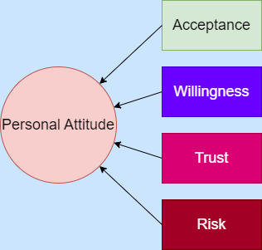
3.2.6 Results - Theme 5: Personal Attitude
Acceptance:
82% excited, 14%neutral, 4% not excited.
67.5% concerned, 22.5% neutral, 11% not concerned.
76% More benefit than harm, 20% neutral, 4% disagree.
85% look for tools and support.
Willingness:
51% with assistance vs 4% without assistance.
Level of confidence 31% -> 67%.
77% would become radiologists again with current AI knowledge.
85% willing to use.
Trust:
Explanation: strong > no > weak.
58.5% revealed inconsistency in trusting AI.
25% shows trust.
Risk:
42% doubt quality and safety.
58% funding is uncertain.
33.33% legal and regulatory issues.

Slide 39
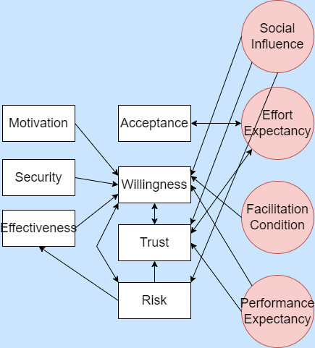
3.2.6 Discussion - Theme 5: Personal Attitude
Radiologists are excited about AI.
They are willing to embrace the innovation.
The majority think the accuracy in diagnosing diseases are the same with or without AI.
Tools and support are essential!
Weak explanations are confusing.
The trust index is not high enough.
Funding and legal risks are the most concerning.
Shows controversy, willingness and acceptance are high, trust is low. Not normal.

Slide 40
3.2.7 Conclusion
Why do people have a positive attitude towards AI and influence others to adopt AI?
Knowledge
We propose:
Further study into knowledge as an important factor in radiologists accepting AI

Slide 41
3.3 Requirements
Hosting Options Include:
Cloud-Based using Qure.AI’s servers (Our choice) Or
Client’s Own Services
API Based-Private Cloud
API Based-Local IT Infrastructure
Cloud-based does not require any specific requirements for the Radiology practice and do all the maintenance for the program. So radiology practices can focus on important tasks instead
Notes:
if you decide to not go the AI Marketplace route, common hosting requirements are:
Cloud-Based using Qure.AI’s servers which are predominantly through AWS and Microsoft Azure
Or
Clients Own Services - No specific requirements are listed on provided from the Qure.ai representative. However, common hardware requirements are High-performance servers, AI-enabled GPU’s and large storage systems with backup drives in case of failure.
API Based-Private Cloud
API Based-Local IT Infrastructure
We suggest using Qure.AI’s cloud-based services. AWS and Microsoft Azure are highly secure reputable cloud hosting options and do not require any specific requirements for the Radiology practice and do all the maintenance for the program. By having the computer server, data storage, firewall, load balancer managed externally, it means radiology practices can focus on important tasks instead of doing mundane tasks such as patching and updates.

Slide 42
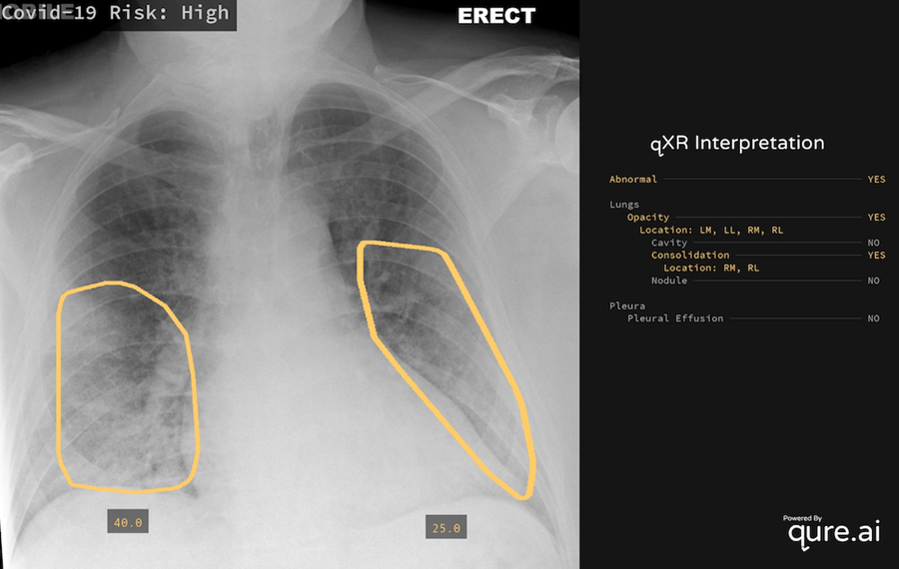
3.4 Interoperability
Identify different types of
abnormality.
Diagnose up to 24 diseases.
Results are easy to store and extract.
A choice between cloud and local.
Location of abnormal highlighted.
Diseases diagnosed listed.

Slide 43
3.5 Data Access
Images can be made available to all physicians with their logins. These can be shared with external physicians
Notes:
Pushpendra Rawat revealed: ‘For cloud based & on-premise (intranet) deployments all images can be made available to all physicians with their logins. These can be shared with external physicians as well with just a web-link as well. An original image is also given to remove any biases for the readers

Slide 44
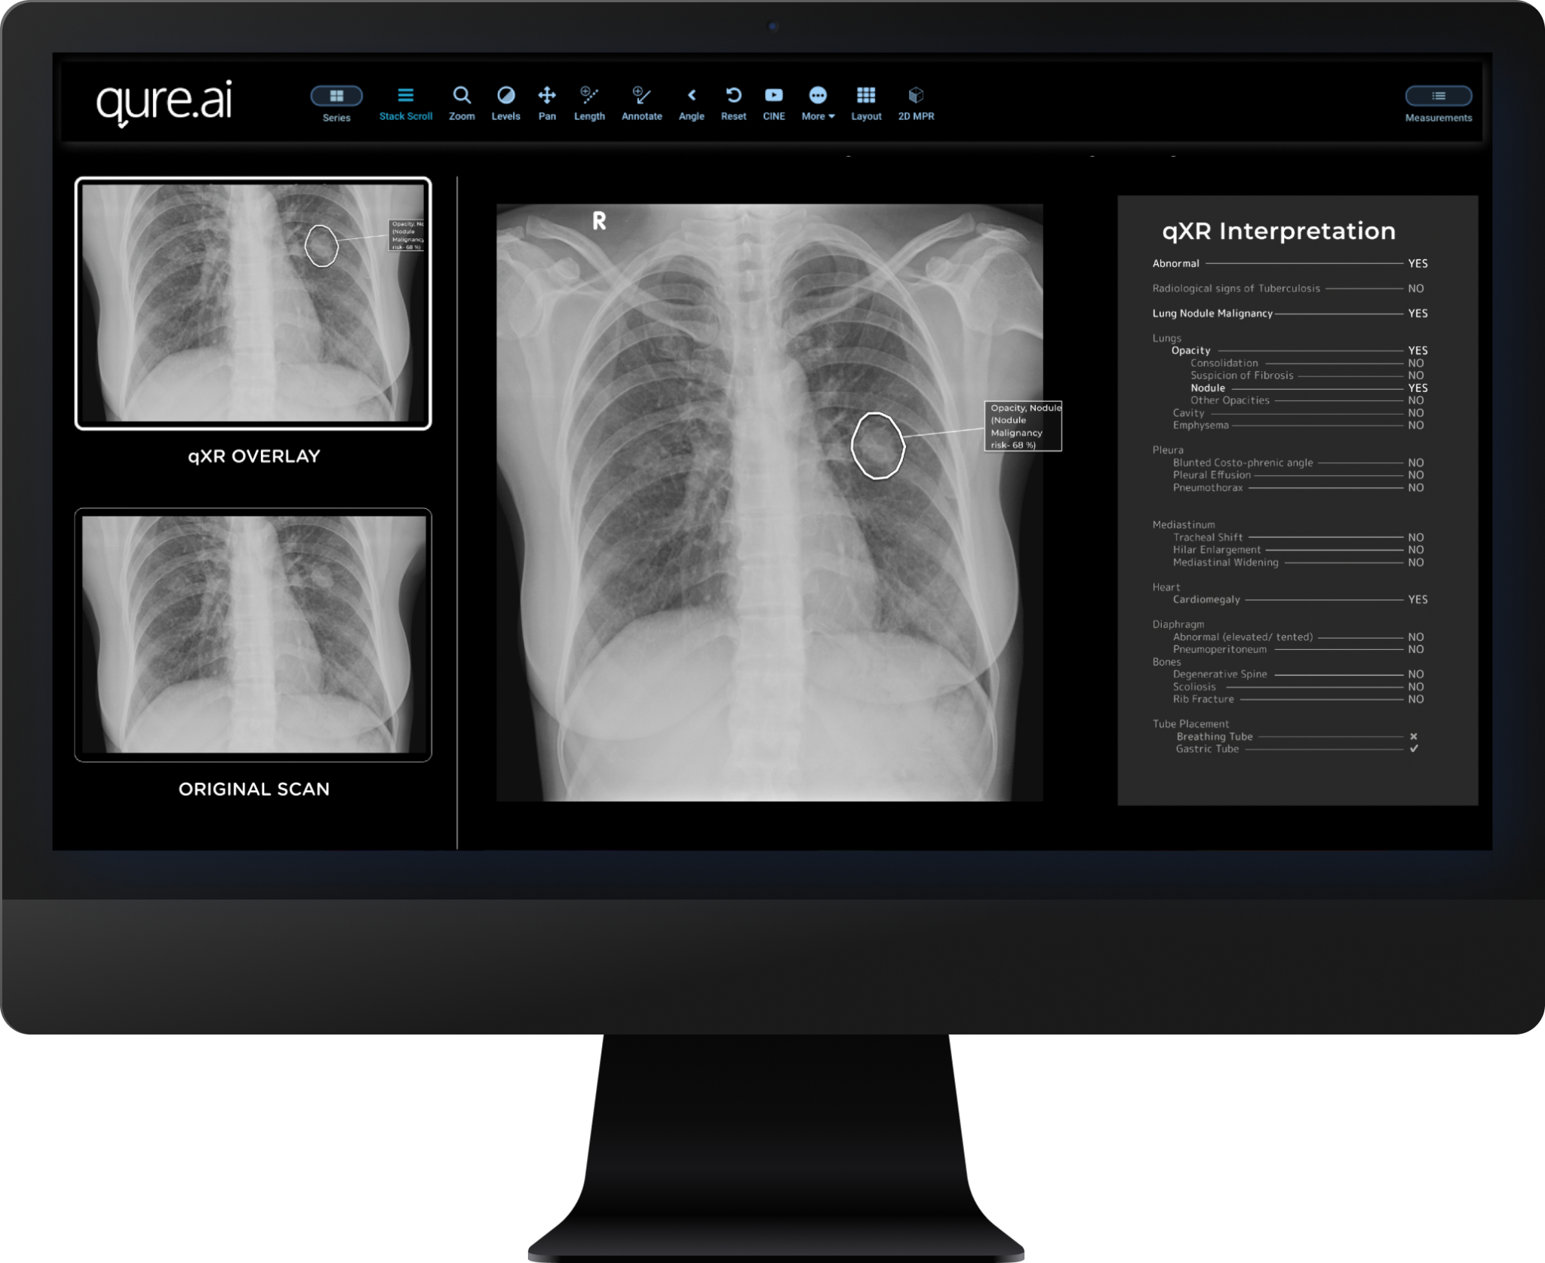
3.6 Results Interpretability
The structured report involves:
Probability score as well as dichotomous output indicating whether each abnormality is present or absent
Probability score for TB as well as dichotomous output indicating whether TB is likely present or likely absent
A box indicating the location of the abnormalities
Abnormalities detected by the product for which a separate abnormality score is given include: abnormal, TB etc.
Notes:
‘Secondary capture has AI annotations on top of the original image. A DICOM viewer also comes along with it with tools such as measurements, levels, zoom etc.’
The generated report is easily interpretable for all medical healthcare professionals, clearly stating if there is or is not a detection of a certain abnormality. This simple reporting structure decreases the time for a practitioner to interpret the results, hence improving efficiency in the workplace.
The structured report involves:
Probability score as well as dichotomous output indicating whether each abnormality is present or absent
Probability score for TB as well as dichotomous output indicating whether TB is likely present or likely absent
A box indicating the location of the abnormalities
Abnormalities detected by the product for which a separate abnormality score is given include: abnormal, TB etc.

Slide 45
Regulatory and Legal Aspects
04

Slide 46

4.1 Australian Medical Device Regulation
Therapeutic Goods Act 1989 (Cth)
Medical devices must be included on the Australian Register of Therapeutic Goods
Issue:
qXR is not included on this Register

Slide 47
4.1.1 Medical Device Regulations Compliance Process
Manufacturer’s Evidence Application
Class IIa CE-mark certification, European Economic Area
Inclusion on the Register Application
Purpose: Qure.ai states that its intended purpose is to aid in the detection of abnormal findings on a chest x-ray
Certification: likely class IIa
6 Essential Principles

Slide 48
4.1.2 Recommendation
qXR is likely to be approved for use in Australia because it is already approved in Europe, it simply requires a sponsor to complete the applications for it to be included on the Register.
We recommend that ABC seeks a sponsor for qXR to avoid the start-up and ongoing regulatory burden of being responsible for qXR itself.
Sponsor: the Australian resident who imports the goods

Slide 49
4.2 Data Protection Regulations
Privacy Act 1988 (Cth)
Australian Privacy Principles (APPs)
Assumption: ABC already complies with the APPs

Slide 50
4.2.1 Australian Privacy Principles
Management of personal information in an open and transparent way
Collection of personal information
Use and disclosure of personal information
Integrity of personal information
Access to and correction of personal information.

Slide 51
4.2.3 Recommendation
International compliance:
United States Health Insurance Portability and Accountability Act
European Union’s General Data Protection Regulations.
We recommend that qXR will comply with Australia’s data protection regulations, however, ABC will likely need to take steps to ensure their ongoing compliance, such as updating their privacy policy.

Slide 52
Financial and Support
05

Slide 53
5.1 Licensing Model
Demo available.
Pricing:
Pay per use.
Differs according to region.
Recommend using AI marketplace.
AI marketplaces help with implementation.
“Competitive” pricing.
Factors:
Number of annual studies
Number of concurrent users
Number of sites
Further specific requirements

Slide 54
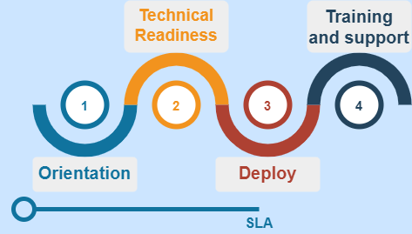
5.2 User Training
Client engagement team.
+
Project delivery team.
Helps install, deploy, and implementation.

Slide 55
5.3 Maintenance
A dedicated team which provides support for all our clients in running the services. There is no AMC for cloud deployments.
Notes:
a dedicated team which provides support for all our clients in running the services. There is no AMC for cloud deployments.

Slide 56
5.4 Handling of Malfunctions and Erroneous Results
Errors are identified by comparing the results of multiple qXR scans of the same patient to look for discrepancies and reviewing error logs,
Potential malfunction is detected from qXR, the system will automatically generate a notification to the user.
There are a few potential consequences of erroneous results:
Inaccurate results
False positives
False negatives
Delayed results
Notes:
The process for identifying potential malfunctions and erroneous results from qXR scans may vary depending on the particular implementation However, some possible methods for identifying such errors could include comparing the results of multiple qXR scans of the same patient to look for discrepancies and reviewing error logs,
If a potential malfunction is detected from qXR, the system will automatically generate a notification to the user. The qure.ai team will then investigate and determine the root cause.
There are a few potential consequences of erroneous results:
Inaccurate results – If qXR malfunctions, it could provide inaccurate results. This could lead to patients not getting the proper treatment or diagnosis.
False positives – This could lead to patients being unnecessarily sent for expensive and invasive molecular testing for conditions they do not have
False negatives – This could lead to patients not getting the treatment or diagnosis they need and can then go on to infect others
Delayed results – Another potential consequence of a qXR malfunction is delayed results. This could cause a delay in treatment or diagnosis, which could be detrimental to the patient.
Medical healthcare readers must be aware of the consequences of potential malfunctions and erroneous results from qXR by qure.ai. Having the clinic’s physicians consistently check the software can prevent incorrect diagnoses and time delays, as they can temporarily stop the upcoming chest x-rays that need to be processed. This will allow time for the software to be fixed and in the meantime getting a radiologist to do the entire CXR reading .

Slide 57
Conclusion
6

Slide 58
ECLAIR Recommendations
Relevance
Invest in qXR to take advantage of its benefits
Maintain a risk register to monitor and manage potential risks
Performance and Validation
Invest in qXR because it is a thoroughly trained and adaptable algorithm that accounts for biases
Usability and Integration
Use an AI marketplace vendor to simplify integration of the AI into the workflow.
Provide staff with support and resources to equip them with the knowledge to understand, trust, and use qXR
Regulatory and Legal Aspects
Seek a sponsor for qXR for it to become legally approved in Australia
Financial and Support Services Considerations
Determine the number of annual studies, concurrent users, and sites to receive indicative pricing

Slide 59
Recommendation
6.1
We recommend ABC health services to proceed with a pilot of qXR
AI technology is an emerging technology in medical imaging
qXR performs the best in DTA studies
qTrack platform
Identify efficiency and accuracy of qXR performance on UX side

